Slide 1
Refinements – A new feature of Ruby
Shugo Maeda
2012-10-20T15:00:00 - 2012-10-20T15:45:00

Slide 2
Who am I?
Shugo Maeda
Ruby committer
Director of the Network Applied Communication Laboratory
Secretary General of the Ruby Association

Slide 3
What's Ruby Association?
Organization dedicated to Ruby's
Development, and
Grant program
Maintenance of the stable version
Promotion
Certification for Ruby programmers
RubyWorld Conference (Nov 8 – Nov 9)
Seminars

Slide 4

I love motorcycles

Slide 5

I love fishing

Slide 6

I love my family

Slide 7
Today's topic
Refinements
A new feature of Ruby 2.0

Slide 8
Background – existing class extensions
Subclassing
Mix-in
Singleton methods
Monkey patching

Slide 9
Subclassing
class Person
attr_accessor :name
end
class Employee < Person
attr_accessor :monthly_salary
end

Slide 10
Ruby's subclassing
Single inheritance
Superclasses aren't affected
Implementation-only inheritance
Violations of LSP

Slide 11
LSP
Liskov Substitution Principle
An instance of a subtype must behave like an instance of the supertype of the subtype
def print_name(person)
puts person.name
end
Person
Employee

Slide 12
An example of LSP violation in Ruby
class Employee < Person
undef name
end
def print_name(person)
puts person.name
end
matz = Employee.new
matz.name = "Yukihiro Matsumoto"
print_name(matz) #=> undefined method

Slide 13
Implementation-only inheritance
Subclassing is not Subtyping
Duck typing
def print_name(person)
puts person.name
end
Person
Employee
need not be a subclass of Person

Slide 14
Mix-in
class; Stream; ... end
module Readable; ... end
class ReadStream < Stream
include Readable
end

Slide 15
Limited multiple inheritance
multiple modules can be included
at most one superclass
<<module>>
Readable
<<module>>
Writable
Stream
<<mix-in>>
<<mix-in>>
<<mix-in>>
<<mix-in>>
ReadStream
ReadWriteStream
WriteStream

Slide 16
Linearization of mix-in
Stream
class Stream; end
module Readable; end
module Writable; end
class ReadWriteStream < Stream
include Readable
include Writable
end
<<module>>
Readable
<<module>>
Writable
ReadWriteStream

Slide 17
Singleton methods
matz = Person.new
def matz.design_ruby
...
end
matz.design_ruby
shugo = Person.new
shugo.design_ruby #=> NoMethodError

Slide 18
Singleton classes behind singleton methods
Person
shugo
<<instanceOf>>
<<singleton>>
Matz
matz
<<instanceOf>>
+design_ruby()
A singleton class has only one instance

Slide 19
Limitation of singleton methods
Singleton methods can't be defined for Numeric objects
x = 123
def x.foo #=> TypeError
puts "foo"
end

Slide 20
Monkey patching
# reopen Person, and add code
class Person
attr_accessor :age
end
shugo = Person.new
shugo.name = "Shugo Maeda"
shugo.age = 34

Slide 21
Monkey patching affects all instances
shugo
Person
<<instanceOf>>
+name()
+name=(val)
+age()
+age=(val)
<<instanceOf>>
matz

Slide 22
Examples of monkey patching
Ruby on Rails
ActiveSupport
Rails plugins
RSpec
Standard libraries
jcode
mathn

Slide 23
Monkey patching version of LSP
An instance of a monkey patched class must behave like an instance of the class without the patch
Otherwise, it breaks existing code
Because monkey patching affects globally

Slide 24
Example of LSP violation
# Fixnum#/ returns an integer
p 1 / 2 #=> 0
# With mathn, Fixnum#/ returns
# a rational number
require "mathn"
p 1 / 2 #=> (1/2)

Slide 25
Extensibility and modularity
Type of class extensions | Extensibility | Modularity
Subclassing | Poor | Excellent
Mix-in | Poor | Excellent
Singleton methods | Good | Good
Monkey patching | Excellent | Poor

Slide 26
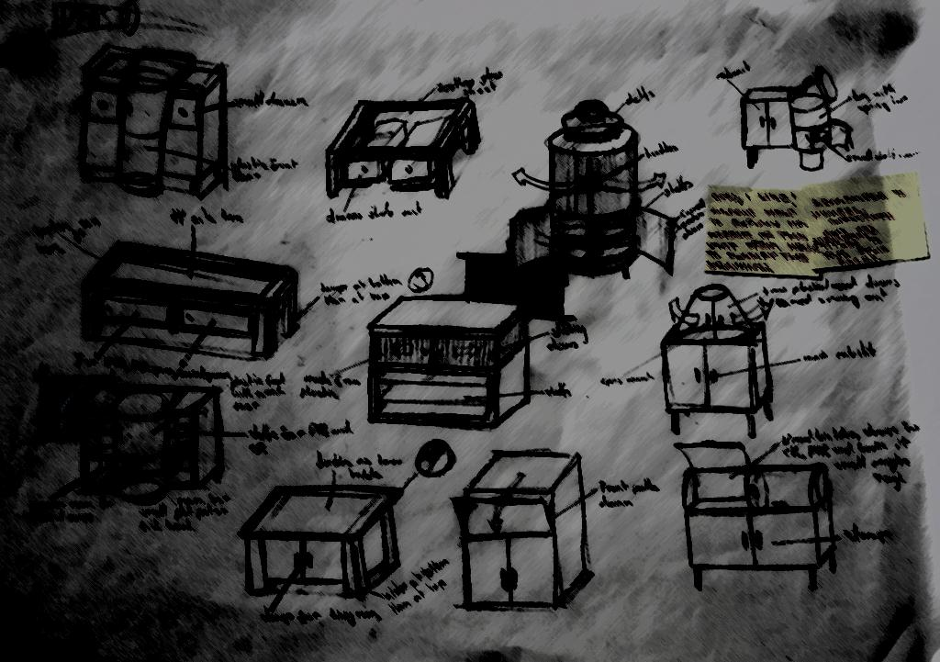
What are Refinements?
A new way to extend classes
Copyright (C) 2006 Jordanhill School D&T Dept's

Slide 27

WARNING
Refinements are experimental, and may be removed from Ruby 2.0!

Slide 28
Terms and definitions
class extension
a computational entity which extends a class or module
Refinements
a mechanism to extend classes and modules locally
refinement
a class extension used in Refinements

Slide 29
Design policy
Extensible
Refinements can extend existing classes
Modular
Lexically scoped
No new syntax/keyword
Use methods and blocks to extend classes
No new semantic entity
Use modules as namespaces of refinements

Slide 30
Example of a refinement
module MathN
refine Fixnum do
def /(other) quo(other) end
end
p 1 / 2 #=> (1/2) affected
end
p 1 / 2 #=> 0 not affected

Slide 31
A refinement is a module
Module#refine creates an anonymous module called refinement MathN$Fixnum denotes the refinement in this presentation (not valid Ruby code)
module MathN
refine Fixnum do
# self is a created refinement here
end

Slide 32
Relationship between a class and its refinement
20
Fixnum
<<instanceOf>>
+/(other)
p 20 / 9
module MathN
...
p 20 / 9
end
<<refine>>
<<module>>
MathN$Fixnum
+/(other)

Slide 33
Multiple refinements in a single module
module ToJSON
refine Fixnum do
def to_json; ... end
end
refine String do
def to_json; ... end
end
end

Slide 34

Scope of refinements

Slide 35
Using refinements in other modules
module MyModule
using ToJSON
p "foo".to_json #=> "\"foo\""
end
p "foo".to_json #=> NoMethodError

Slide 36
Using refinements in toplevel
foo.rb bar.rb
using ToJSON
p "foo".to_json #=> "\"foo\""
load("bar.rb")
p "bar".to_json #=> NoMethodError

Slide 37
Lexical scope
def foo
p 1 / 2
end
module Bar
using MathN
p 1 / 2 #=> (1/2)
foo #=> 0
end

Slide 38
Why lexically scoped?
Not to break existing code
Third party libraries might expect the original behavior of Fixnum#/
Learn from the history of local variables

Slide 39

Stacking classes and refinements

Slide 40
super in refined methods
refine String do
def +(other)
if encoding == Encoding::ASCII_8BIT
super(other.force_encoding("ASCII-8BIT"))
else
super(other)
end
end
end
original String#+ is called

Slide 41
Linearization of refinements
class Foo; end
module FooExt1
refine Foo do ... end
end
module FooExt2
refine Foo do ... end
end
module FooExtUser
using FooExt1
using FooExt2
Foo.new.do_something
end
Foo
super
<<module>>
FooExt1$Foo
super
<<module>>
FooExt2$Foo

Slide 42
Subclassing and refinements
class Foo; end
class Bar < Foo; end
module FooExt
refine Foo do ... end
end
module BarExt
refine Bar do ... end
end
module FooBarExtUser
using FooExt
using BarExt
Bar.new.do_something
end
Foo
<<module>>
FooExt$Foo
super
Bar
<<module>>
BarExt$Bar

Slide 43
Inheritance of refinements
module ActiveRecord
class Base
using ActiveSupport::Refinements
end
end
class Article < ActiveRecord::Base
# ActiveSupport::Refinements is
# available here
end

Slide 44
Mix-in and refinements
module MyHelper
using ActiveSupport::Refinements
end
class Article
include MyHelper
# ActiveSupport::Refinements is
# NOT available here
end

Slide 45

Metaprogramming with refinements

Slide 46
module_eval
MathN.module_eval {p 1 / 2} #=> (1/2)
module Foo
using MathN
end
Foo.module_eval {p 1 / 2} #=> (1/2)

Slide 47
Get refinements from modules
module ToJSON
refine Fixnum do ... end
refine String do ... end
end
p ToJSON.refinements
#=> {Fixnum=>#<Module:0x22528f4c>, String=>#<Module:0x22528ed4>}

Slide 48
Using refinements globally
def using_globally(mod)
mod.refinements.each do |c, r|
c.send(:prepend, r)
end
end
using_globally ToJSON
p 123.to_json #=> "123"

Slide 49
Module#prepend
<<module>>
Foo
module Foo
end
module Bar
end
class Baz
include Foo
prepend Bar
end
Baz
<<module>>
Bar

Slide 50

Use cases of Refinements

Slide 51
Incompatible extensions
Refinements can break compatibility safely
Refinements are lexically scoped

Slide 52
rationalize
Refinement version of mathn
require "rationalize"
module Foo
using Rationalize
p 1 / 2 #=> (1/2)
end
p 1 / 2 #=> 0

Slide 53
Backward compatibility
String#lines will be changed to return an Array instead of an Enumerator (#6670)
module StringBackwardCompat
refine String do
def lines(*args, &block)
each_line(*args, &block)
end

Slide 54
Case expression elimination
Case expressions should be replaced with dynamic dispatching
However, it's not good to add methods to built-in classes
Refinements can be used in such cases

Slide 55
Example of a case expression
From xmlrpc/create.rb:
def conv2value(param)
val = case param
when Fixnum, Bignum
...
when TrueClass, FalseClass
@writer.tag("boolean",
param ? "1" : "0")
...

Slide 56
Examle of case expression elimination
module XMLRPC
[TrueClass, FalseClass].each do |c|
refine c do
def to_xml(writer)
writer.tag("boolean",
self ? "1" : "0")
end
end
end

Slide 57
Internal DSL
Internal DSLs often extend built-in classes
Refinements can be used to extend built-in classes only in DSL contexts

Slide 58
rspec-refinements
Provides methods like should by refinements
class Foo; def tes; should; end; end
describe Foo do
it { should be_a Foo }
specify {
expect { Foo.new.tes }.to \
raise_error(NameError)
}
end

Slide 59
activerecord-refinements
Provides operators in where conditions by refinements
User.where { :name == "matz" }.first
User.where { :age >= 20 }.all
:age >= 20 #=> ArgumentError

Slide 60

Are refinements slow?

Slide 61
Benchmark code
module M; def foo; end; end
class C; include M; def bar; end; end
module MExt
refine M do def foo; end end
end
module CExt
refine C do def bar; end end
end

Slide 62
Benchmark code (cont'd)
N = 10000000
def run(bm, name, mod, obj, mid)
call_100_times = 100.times.map { "obj.#{mid}" }.join("; ")
bm.report(name) {
mod.module_eval("#{N / 100}.times { #{call_100_times} }")
}
end
Benchmark.bmbm do |bm|
c = C.new
run(bm, "no refinement", Object, c, "bar")
run(bm, "class refinement", CExt, c, "bar")
run(bm, "module refinement", MExt, c, "foo")
end

Slide 63
Benchmark result

Slide 64
Benchmark result (without method cache)
3.21x
1.26x

Slide 65
Conclusion
Refinements are extensible and modular class extensions

Slide 66
Previous works
Selector namespace
SmallScript, ECMAScript 4
Classbox
Smalltalk, Java
import-module, class-in-state
Ruby

Slide 67
Thank you!

